Slide 1

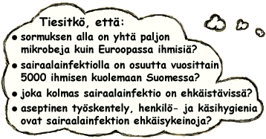


ASEPTICS IN SOCIAL AND HEALTHCARE

Slide 2
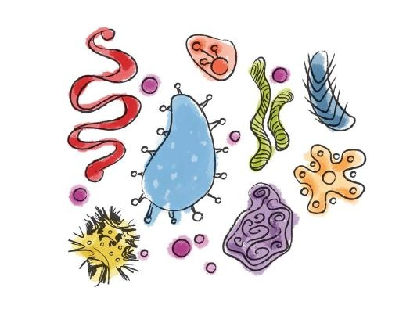

PERSONAL HYGIENY,
How do you take care of it as healthcarelogisic

Slide 3

HANDS CONDITION
Hands are the most important instrument for healthcare logistian, you schould take care of those carefully
Basic rules fo handhygieny
  Short nails, clean hands, no nailpolish
  No rings ar watches
  No wounds or infected nailwalls
  Healty skin
  Proper handwash
  Hand desinfection
  Proper use of gloves
  handemulsions

Slide 4
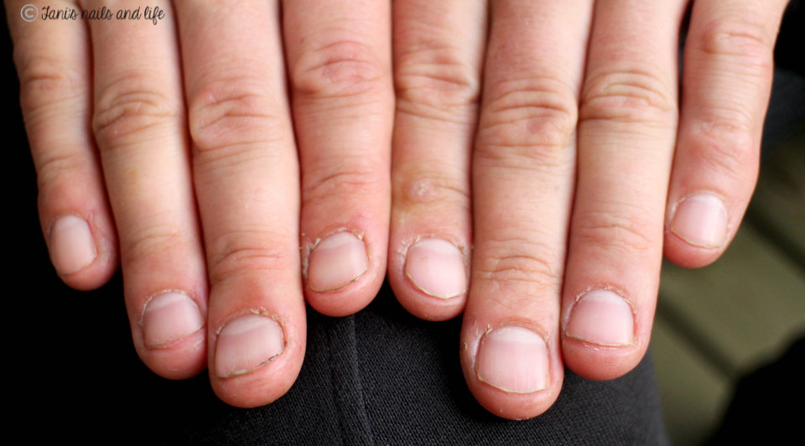

Slide 5
CARE OF NAILS
Cut your nails and use nailfile
Under long nails are microbes
Long nails may harm patients
Long nails may broke the gloves
Bitting nails is not hygienic
Your nails are too long if you see them looking back of your palm
Do not polish your nails because the desinfection item brokes the cover of your nail and many bacterias may sit on it.

Slide 6
Make a aseptic test for you classmate
CONDITION OF YOU HANDS:
Nails
2. Nail walls
Wounds, brokes
Finger spacings
jewerelly
piercings
tatues
others
”LOOK OF HEALTCARELOGISTIAN”
Hair
Earringsand jewerelly
makeupp
pearcing
tatues
parfymes
Mustache, beard

Slide 7
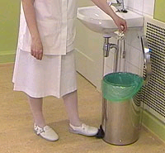
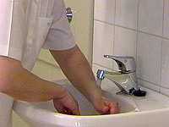
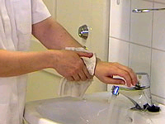
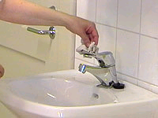
THE PROPER HANDWASH
)

Slide 8
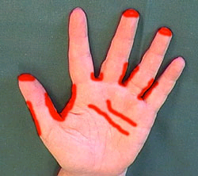
THE PALCES WHICH USUALLY LEFT BAD AFTER HANDWASH

Slide 9
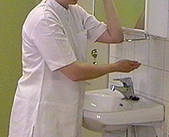
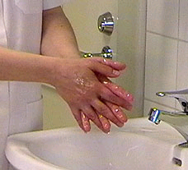
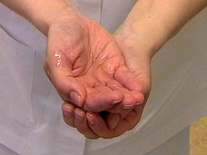
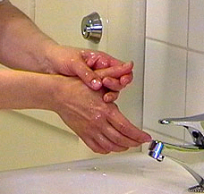
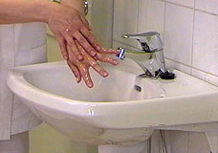
THE PROPER HANDDESINFECTION

Slide 10
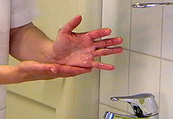
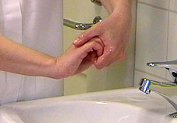
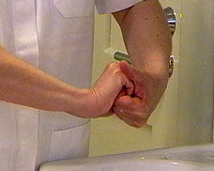
THE PROPER HAND DESINFECTION

Slide 11
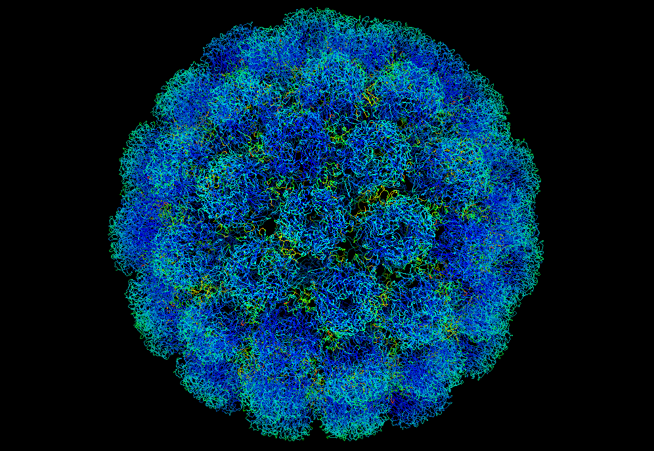
Anser to next questions concerning Covid-19 https://www.youtube.com/watch?v=I1yvrMwlgBI
What is pandemia and what is epidemic?
How do you protect yourself in epidemic?
What kind of methods you may use?
Who are in the biggest risk?
How do you prevent the contamination?
What are the symptoms of Covid-19t?
How Covid-19patients is treated and taken care?
What is your point in logistic point of view in Covid-19 prevention?

Slide 12
Infection prevention
When?
How?
https://www.youtube.com/watch?v=-KksxH92gwc
Erasmus+ KA2 Strategic Partnership
2017-1-1FI01-KA203-034721
Healthcare Logistics Education and Learning Pahtway

