Slide 1
Foundation Hospital Calahorra.
Lean Management applied to operating rooms.

Slide 2
Content of Case Studies
Background
Theoretical framework
Implementation
Results
Conclusions

Slide 3
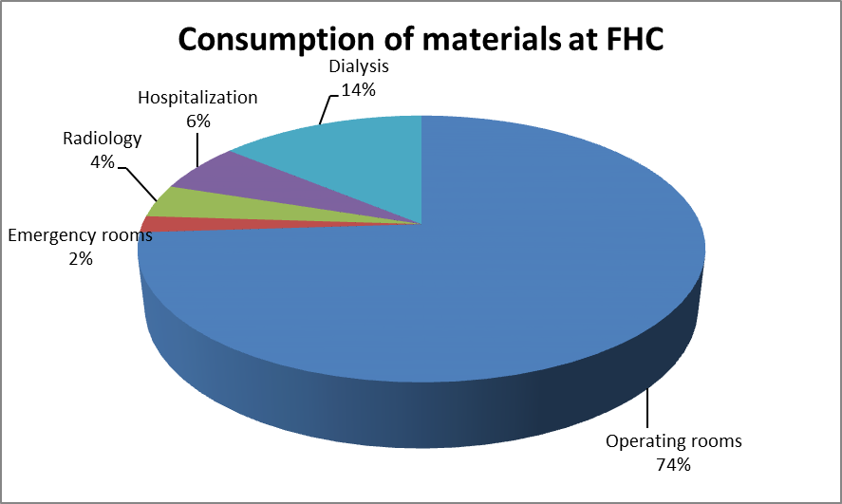
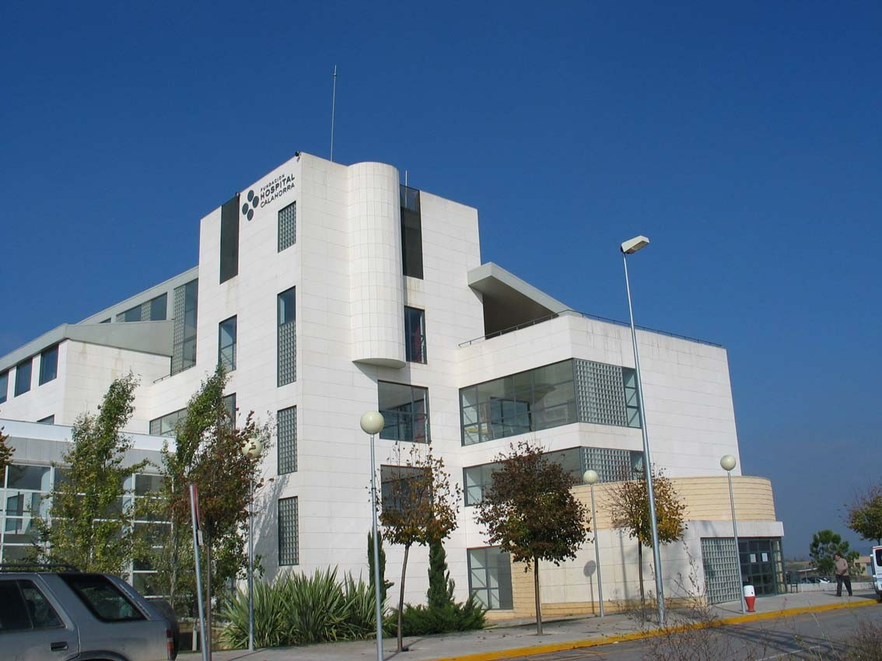
Background
Fundación Hospital Calahorra is a public hospital located in La Rioja (Spain).
In 2009, it comprised four operating rooms, with a surgical activity of 4,528 operations, of which 3,829 (84%) were scheduled and 699 (16%) urgent.
To fulfil this demand:
63 items managed in the operating room (Kanban double bin)
380 SKU held in trust/deposit method
150 SKU on demand depending on the planning

Slide 4

Background
Management of these types of supplies is complex (expensive, uncertainty, sometimes vital importance).
Many non added value activities.
Disconnection between logistics operations-healthcare activities.
Bad working environment among nurses and logistics workers.
Objective: INCREASE INTERNAL CUSTOMER SATISFACTION applying lean management principles

Slide 5

Theoretical Framework
There are five basic principles of lean thinking¹:
Value
The Value Stream
Flow
Pull
Perfection
What does it mean “value” in this context?

Slide 6
Implementation
Weekly meetings (Kaizen) in the operating room between logistics managers and the operating room coordinator.
The coordinator explains which actions add value for the costumer.
Excel spreadsheet to monitor and follow-up in the next meeting.

Slide 7
Implementation
After 4 months of Kaizen meetings, the following areas to improve were identified:
1.- The deposit method was not working well.
2.- Critical supplies needed to be replenished whithin 24h. Although there was an on-line management system to place the order to the supplier directly from the operating room, it wasn’t being used.
3.- Need to fine-tune some of the supply and replenishment processes.
4.- Kanban system already implemented could be improved.
5.-Ininadequate identification and placement of some of the supplies.
6.-Excessive waste of time filling in unnecessary information in the implant sheets, opening incidences for lack of access to the computer system, error when printing, etc.
7.-Lack of mutually agreed indicators.
66 improvement actions

Slide 8
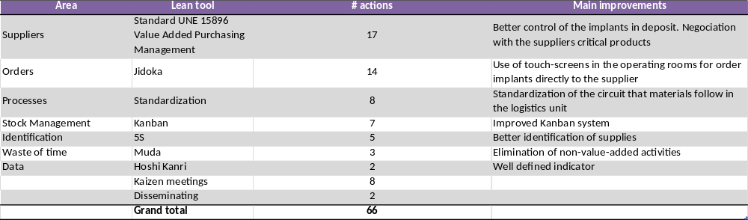
Implementation
66 improvement actions

Slide 9
Results
The results obtained were: l Optimization of the operating room stock in the specialties of urology and surgery € 3,850 l Time saved in the generation of Traumatology implant orders, 1 hour daily
Optimization of the operating room stock in the specialties of urology and surgery € 3,850.
Time saved ordering orthopaedic implants after a surgery , 1 hour daily.
Time saved in eliminating the manual filling of unnecessary information, 1 hour daily.
Increased internal costumer satisfaction.

Slide 10
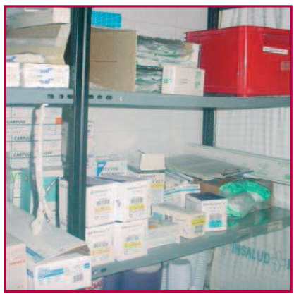
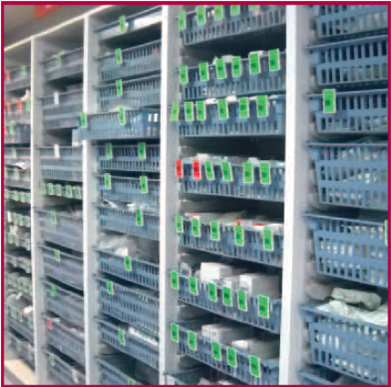
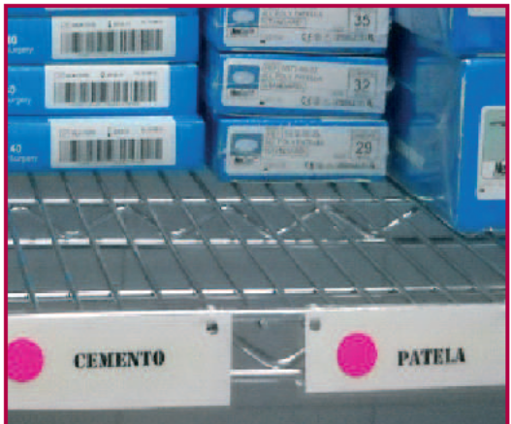
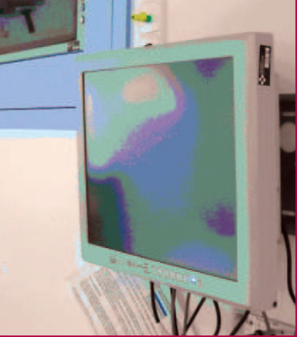
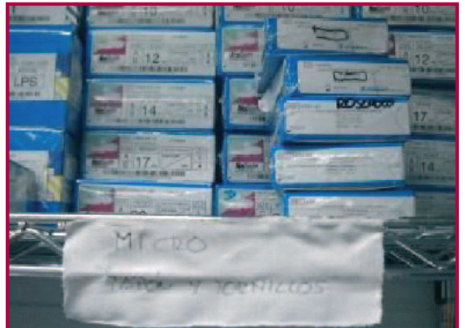
Results
The results obtained were: l Optimization of the operating room stock in the specialties of urology and surgery € 3,850 l Time saved in the generation of Traumatology implant orders, 1 hour daily

Slide 11
Conclusions
The results obtained were: l Optimization of the operating room stock in the specialties of urology and surgery € 3,850 l Time saved in the generation of Traumatology implant orders, 1 hour daily
Sometimes “ethereal” feelings hide other underlying problems.
Not all lean projects must imply spectacular economic results from the "numerical" point of view.
Make the personnel involved in both sides; client and supplier (internal or external) work more at ease and more aligned is possibly is a huge challenge.

