Slide 1



The most common equipments, intruments and machines in Healthcare
Salpaus Further Education
Katja Makkonen

Slide 2

In Equipment maintance packages different kinds of goods in different packagingmaterilas
The ward makes packages for diffrent custmers from their omnw wish
Separately in different bags
Sets in diffrents sterilebags with multiply instruments
Operationbaskets
Sterilecomtainers
Boxes
Items with are in desinfectionchain in dust bags

Slide 3
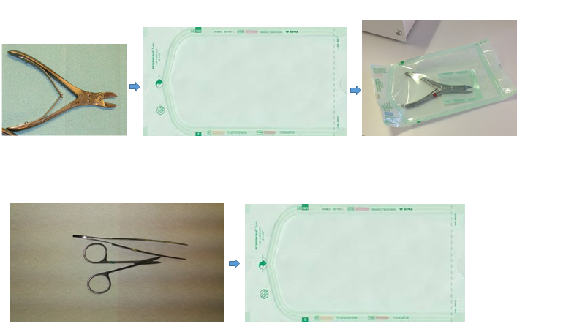

Slide 4
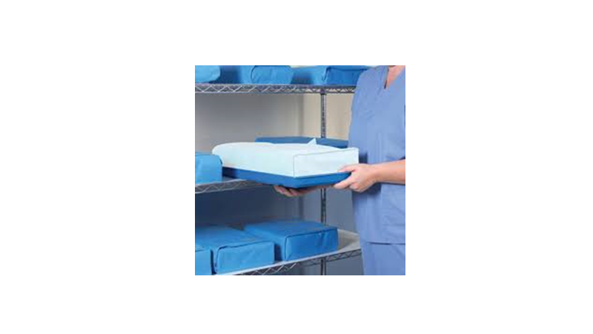

Slide 5
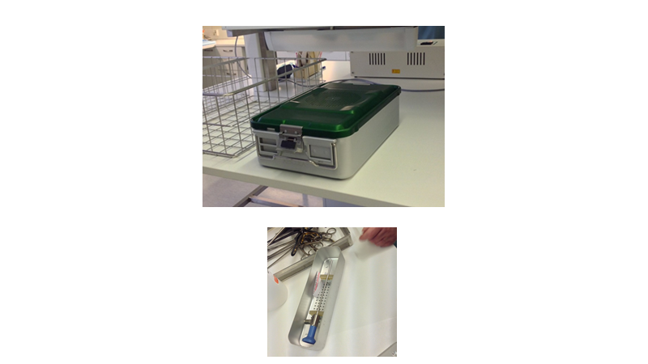

Slide 6
The most common intrumentpackages
Bellow there are some dias with 3 examples of mots common sets in equipment maintainance. Your task is to find from Moodle link, the right intruments into those. Ypou may use aslo Internet for your findings.
Set 1 : Removal of stiches ( Stich removal scissors, anatomy tweesers)
Set 2. Suturation set ( needle conveyor, Mayo scissors, antomy and surgery tweesers))
Set 3: Skinbiopsyset (pastic surgery scissors Rangnell, Kilner), needle conveyor, surgery Adson tweesers)

Slide 7
The most common operationbaskets
Baskets. The dias bellow shows the most common surgery and operationalbaskets. Yous task is to find from Moodle link the right intruments in baskets.
BASIC OPERATION BASKET: peans, criles, Kochers, Mosquito peans, Tuffier peans, needle conveyors, Mayo scissors, anatomy and surgery tweesers, 4 fingercutting hook, Langenbeck cutting hook, trobe, Mikulitz spatula, Adsonwound aplicator, kindey bowl, degel)
BONEBASKET: bonescoops, demels, hammer, awl, bone chisel, bone biter, bone braker)

Slide 8
The most common optics and scopes
Stiff and felxible scopes
Some of the scopes you look trought ocular and may enlarge the view.
Stiff scopes: uroscope, artroscope, laparascope
Felxible scopes: gastroscope, colonoscope, thoracoscope, uroscope

Slide 9
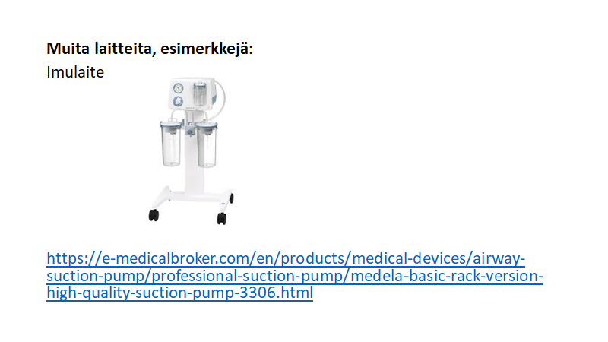
Other machines, examples

Slide 10
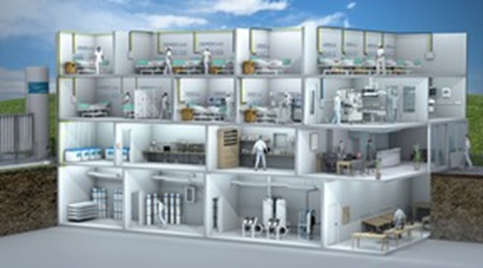
Oxygen
There are differnts oxygensystems in units; wards, operation theatres
The most common gas used in hospitals are medicine oxygen and medicine breathing air.

Slide 11
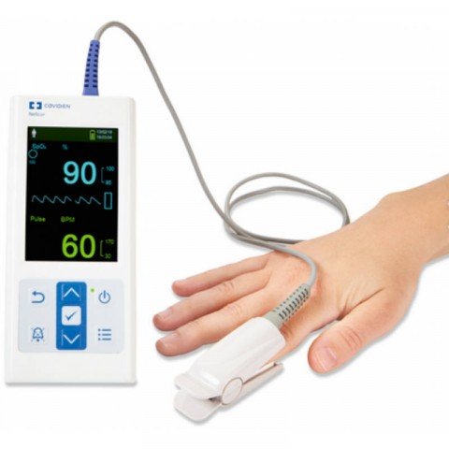
Gasdispelcers and – brackets (in patientrooms)
Pulsoxymeter

Slide 12
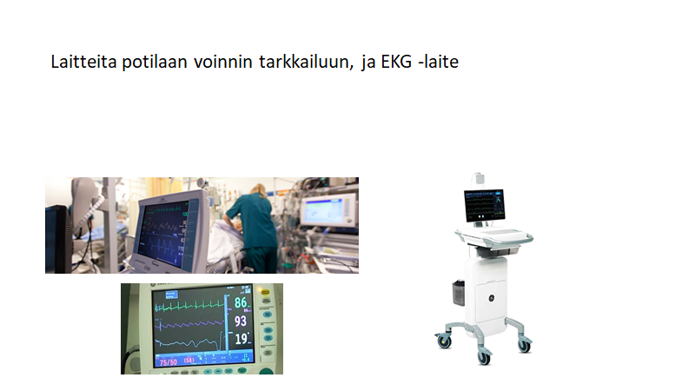
Equipment for monitoring patients

