Slide 1



Customerservice in social and healthcare area and scenes with demanding clients
Healthcarelogistics
Tuula Hovilainen-Kilpinen

Slide 2

ASIAKASPALVELU
h
The best elements for customerservice
https://www.youtube.com/watch?v=uqzWQQTqZy0

Slide 3
Co-opeartion with demanding customer
Rules
In which situations customer is demandin
How do you anticipate the situation?
Face
Movement
space
Equipment ion same space
Hands
Own behavior

Slide 4
Co-operation with agressive customer
Be on same level, eyes by eys
Show your hands
Go to same feeling, if its realistic
Do not stare, be still present
Listen, try to get confidence
Speak respectfully
Make rules together for next time and tell what is Yours method to service customers.

Slide 5
Co.operation with demanding customers
AlarmsHälytysjärjestelmä
Equipment in the same roomEsillä olevat esineet
If there is two healhcarelogistians ain same situation, support your partner. If the customer is aggressive, steer him/her aout of the place.
Make health and safety notice and debfief
ANTICIPATE AS MUCH YOU CAN!

Slide 6
Co-operation with demanding customer
When is ot time to leave the situation?
” Be nice, even the customer is not”

Slide 7
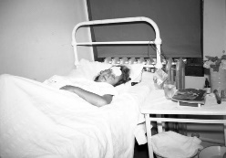
Co-operation with demanding customer https://www.youtube.com/watch?v=r2tE3ShXML0
You are bringing sterile equipment to ward. What do You do?

Slide 8
FEEDBACK FROM CUSTOMERS
There are assessment-criteria for social and healthcare customers, which all providers use. The questions are same for all of the services. Its developed by THL.
All feedback is useable.

Slide 9
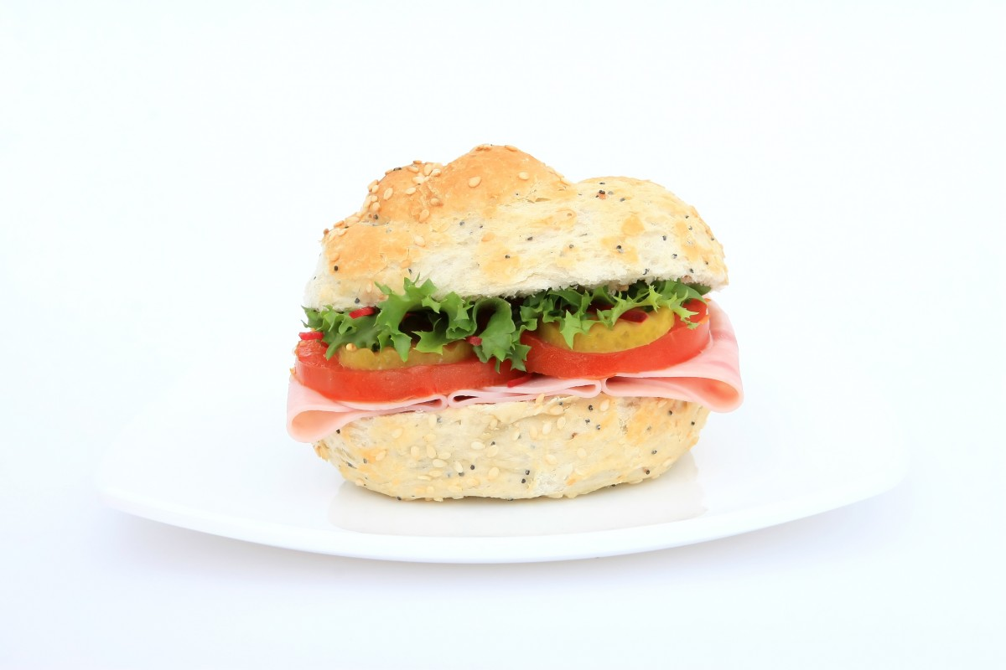







GIVING AND GETTING FEEDBACK

Slide 10
How to give feedback
Yu have been waiting in ER fot three hours and you feel that all others are more important than your health.
What do you do as client?
What do you do as social and healthcare professional?
Erasmus+ KA2 Strategic Partnership
2017-1-1FI01-KA203-034721
Healthcare Logistics Education and Learning Pahtway

Slide 11
How do you get feedback?
You are in a hurry and bringing order to nursing home. You cant find any stuff.
> What do you do?
There are very negative behaving nurse is waiting for you, who does not know where to put the ordered things.
> What do you do?
The nurse is nice, but does not understand anything about the order you are bringing.
> what do you do?

Slide 12
How do you behave in situations like this?
You are bringing medicineorder tho ward. The seal must be checked and sign by the subcriber. Subcriber is having a coffebreak and does not come aout og coffeeroom. She sees you.
What do you do?
Alzheimer disease client want to go home. He clings on you and dont leave you.
What do you do

Slide 13
One patient is dressed in patienclothes and she tries to leave while you are opening the door.
What do you do?
What about then, when patient is leaving and dressed in own clothes and lives in elderly care unit.
What do you do?

Slide 14
How to act in this situation?
Client crabs to your arm. You can feel how his nails are going unter your skin.
What do you do?
https://www.youtube.com/watch?v=3qMwwNMAuOQ
https://www.youtube.com/watch?v=Dn7Let4tICI
https://www.youtube.com/watch?v=WCKj27jzRLI

Slide 15
INDVIDUAL ESSEE FOR NEXT LESSON. Watch and listen a linked video and answer to the questions. https://www.youtube.com/watch?v=WH6rbmA6HJ8
What might be behind the demanding behavior? Mitä on haastavan käytöksen takana?
How can you prevent demanding behavior?Miten voit ennaltaehkäistä haastavaa käytöstä?
How do you get contact to client who is drunk or abused present? How do you get contcat to depressive client?
How do you get contact to self destructive customer?

