Slide 1








EQUIPMENT MAINTAINANCE PROCESS
Salpaus Further Education,
Katja Makkonen

Slide 2
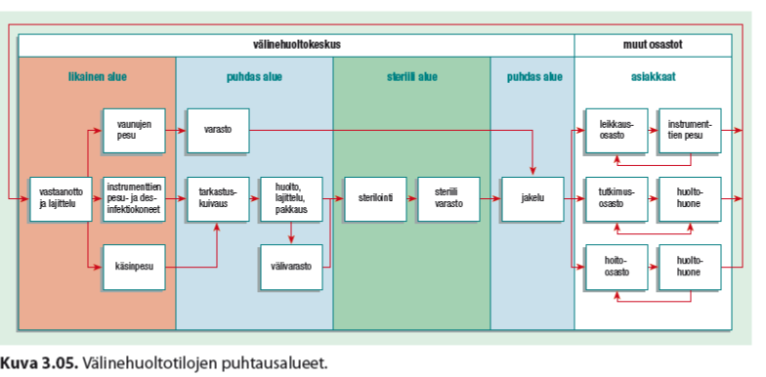
EQUIPMENT MAINTAINACE ANE PURITY LEVELS
Erasmus+ KA2 Strategic Partnership
2017-1-1FI01-KA203-034721
Healthcare Logistics Education and Learning Pahtway

Slide 3
PROCESS
DIRTY AREA:
> all equipment which have been in contact in patients. Equipment reseption, prehandling of equipments, washung and desinfection.
> working safety and isolation!
CLEAN AREA:
Drying, inspection, cheching, packaging, sterilizing, warehousing (" sterile room")
> patient safety, working safety!

Slide 4
REVISION TASK
How are the equipment levelled?
When the equipment is clean and what is the colour of it?
Make same questions to your classmate:)

Slide 5
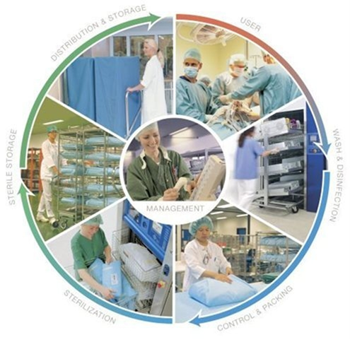
EQUIPMENT MAINTAINANCE IS PART OF INFECTION PREVENTION
The process is:
Prehandling
Wash
Desinfection
Drying
Inspection, checking
Packaging
Sterilization
Warehousing (delivery to custom)
https://www.youtube.com/
watch?v=fIDlOYF57zA

Slide 6
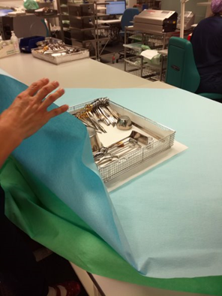
Examples of process
Operation set:
Prehandling
Wash and desnifection
Drying
Inspection and service
Packaging
Sterization
Warehousing

Slide 7
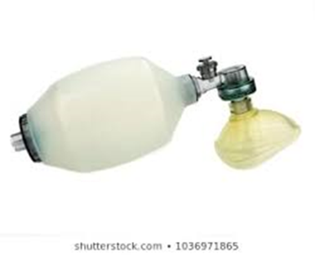
Examples of process
Ambu/ ventilation mask
PREHANDLING
WASHING AND DESINFECTION
DRYING
INSPECTION AND SERVICE
PACKAGING
WAREHOUSING

Slide 8
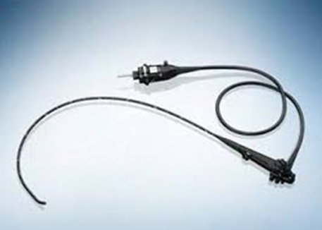
EXAMPLES OF PROCESS
SCOPE, gastroscope
PREHANDLING
WASH, FLUID DESINFECTION
INSPECTION, SERVICE
DRYING
PACKING TO BOX
DELIVERY TO CUSTOMER'
WAREHOUSING

