Slide 1



Equipment maintainance; Purity level and intended use of equipments
Salpaus Further Education
Katja Makkonen

Slide 2

The purity level of medicinery equipmentas
The purity levels is determinated by intended use and target
There are four purity levels:
1. Clean
2. Desinfected
3. Strerilized
4. Sterile

Slide 3
CLEAN:
> clean and factory clean
> equipment is washed and dried, but not desifected
> there are still live microbes on it
> equipments are not not in immediate contact with patient
FACTORY CLEAN:
> the producer is in charge of the rawmaterials, packing and storage of product.
> there are no mikrobes in it
> equipments are mostly disposable

Slide 4
DESINFECTED and STERILIZED
All microbes are killed by physical and cemical methods
Can be used to healthy skin and mucous membrane contacts
Oxygenmasks, intubationtubes, laryngoscope, gynecologic equipments
HIGH LEVEL DESINFECTED
" Fluiddesinfected"
> scopes

Slide 5
STERILIZED ja STERILE
Equipment is washed, desinfected, sterilized, but nor packed
Oral equipments
STERILE
> washed, desinfected, serviced, inspected, packed, sterilized ja storaged product
> use under the skin or mucous membraine, endosscoping surgery, surgery

Slide 6
FACTROY STERILE ITEMS
The equipment and items are sterilezed with different kind of methods
Needles, syringes, packed gauzes, operation instruments

Slide 7
EQUIPMENT USE IN HOSPITAL AND COLOURS TO IT
RED = DIRTY
CONTACT, TOUCHRISK = YELLOW
CLEAN= BLUE
STERILE= GREEN

Slide 8
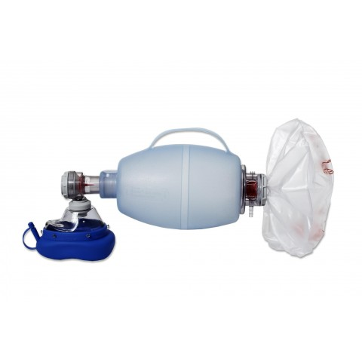
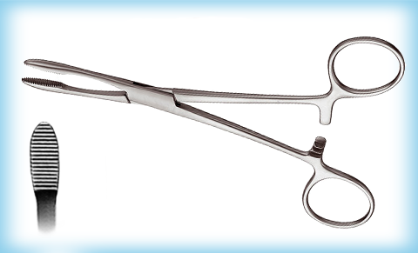
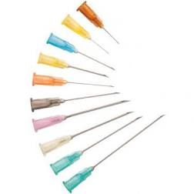


IS THIS EQUIPMENT CLEAN, FACTORY CLEAN, DESINFECTED, STERILIZED, STERILE, FACTORY STERILE?

Slide 9
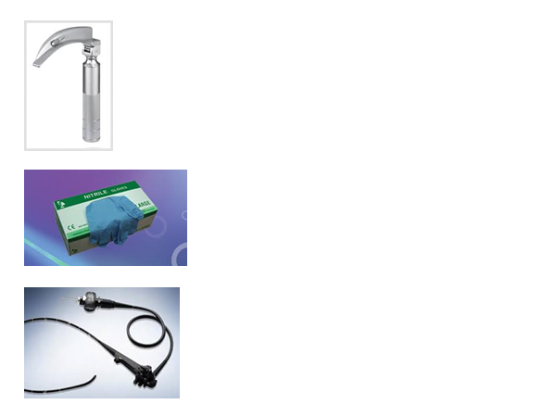
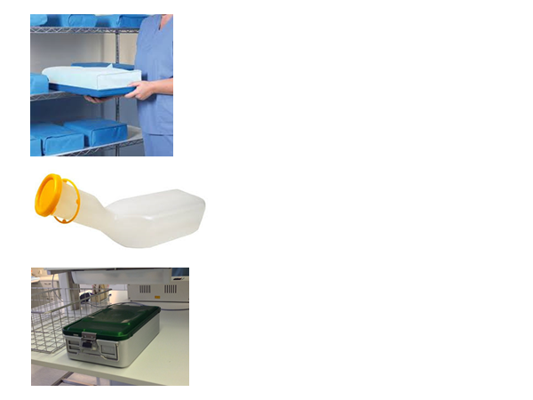
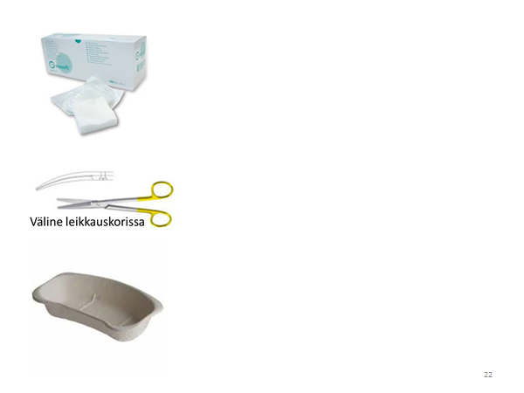

Slide 10
ASEPTICS IN EQUIPMENT MAINTAINACE ( transport, delivery and storage)
Handhygieny
When ypou touch equipment package, do it with desinfected hands. Both with factoryclean and factorysterile packings)

Slide 11
PREVIEW TASK
Preview hand wash and desinfection:
- When you need to wash and desinfect?
When just desinfect?
Technique of hand wash
Techinique of hand desifection
What happends to microbes
> if you just wash your hands?
> if you wash and desinfect your hands?

Slide 12
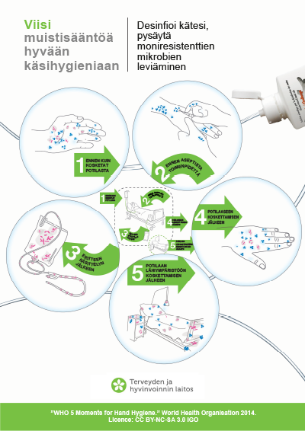
HANDWASH AND HAND DESINFECTION

Slide 13
EQUIPMENT DELIVERY TO CUSTOMER
Different methods
Depends on the customer, the deliveryplace, transport methods
Transport boxes, packages, small and large containers
Be car, taxi, transportrobot, containers
The purity of transportation ways and items

Slide 14
STORAGE/ WAREHOUSING
Customer need to have legal storages
Handhygieny is important in warehouses
Sterile packings need to deliver carefully with desinfected hands
Packages need to storage in airy storage and the oldest ones are in use.
" Take from the top, front, right. Put alwasy bellow, back and left"
* Procucts sticker need to seen
* DO not stack equipmentpackings

Slide 15
STORAGE/ WAREHOUSING
Equipment may also be storaged in sterile storages
The microbe level must be low
Dry room, all materials need to be on clean level
Lockout need to have
Dressing area to isolation clothes before going to sterile storage?
Speaking and talking in there is prohibited.

